Slide 1
SECURE4YOU
DigiEduHack 2023

Slide 2
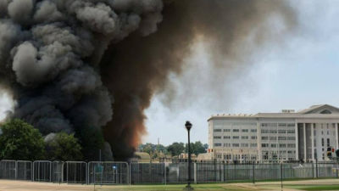
Problems ?
Problems before AI development:
PRIVACY : - codes
- identity theft
- phishing
VIRUSES
With the development of AI the spectrum of problems is expanding.
Artificially generated pictures and videos
Fake news
DigiEduHack 2023

Slide 3
The idea originality
TOOLS | ROLE | DROWBACK
01 Metasploit, WebGoat, Hackbar | data security analysis | no fun or learning
02 Hacknet | hacking simulations | possibility of misuse
03 Internet | Diferent information about certain topic | no fun
DigiEduHack 2023

Slide 4
Benefit of solution, wider social impact and context
Increasing awarness of Internet security
Education about digital risks through game and fun
Spread of current AI topics
Possibility of implementation in schools and less infomatically educated population
DigiEduHack 2023

Slide 5
Sustainabillity of application
Application is sustainable with regular checks
Possibility of implementation in case of new problems of Internet safety that constantly grow and increase of technological development
DigiEduHack 2023

Slide 6
The project realisation
About us :
Resources:
Marketing :
Laura Boras, Marta Katić, Sunčica Prgomet, Gabriela Zdilar
Students of master‘s degree, Mathematics
Desired knowledge and new challenges
Sponsors
Implementation into educational system
Social media
DigiEduHack 2023

Slide 7
Thank you for your attention!

